Slide 1
Exploring Junos Automation with PyEZ
Stacy W. Smith
<stacys@juniper.net> https://github.com/stacywsmith

Slide 3
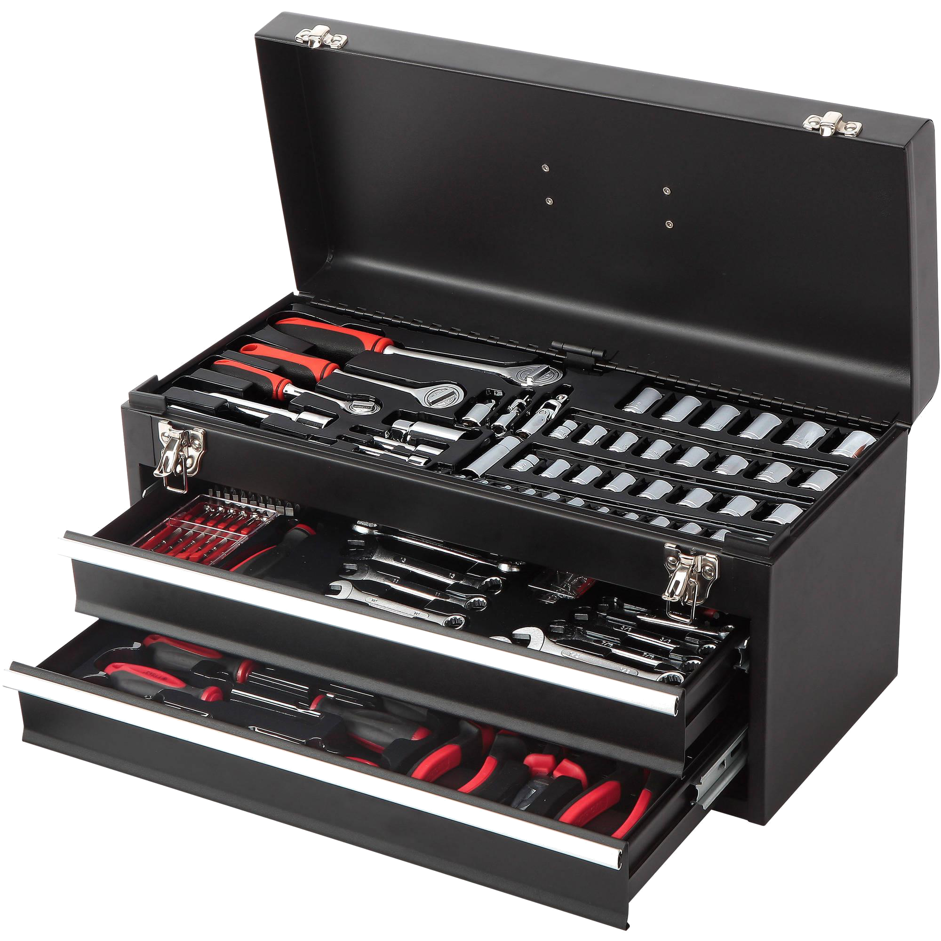
The Junos Automation Toolbox

Slide 4

Junos Automation Stack
Python Scripts
Ansible
SaltStack
Ruby Scripts
Puppet
Chef
JSNAP
CLIRA
JET API
PyEZ Framework
RubyEZ Library
Python / SLAX
Simplicity
Flexibility
gRPC
NETCONF
Junoscript
REST
CLI
JSD
YANG
XML-RPC
jVision Sensor
SNMP RO
MQTT
Ephemeral DB
YANG
jVision
Chassis
Data Plane (PFE)
Junos Platform Automation Stack

Slide 5
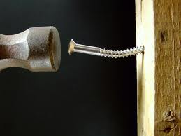
“If the only tool you have is a hammer you tend to see ever problem as a nail.”
- Abraham Maslow

Slide 6

Demonstration Topology
r1
r5
r2
r0
r4
r3

Slide 7
https://github.com/stacywsmith/DJUG-demo

